Slide 1
ITSC 200 – Network Protocols and Security
Security Tools

Slide 2
Today’s Objectives
Understand the firewall software used in Linux
To learn to use :
Port Sentry
ARPwatch
Fail2ban

Slide 3
Linux Firewalls
Linux employs a kernel-based firewall called netfilter.
Most Linux distributions use iptables to view, modify, and create the rules used in the firewall.
The iptables rules can be complex and so some Linux distributions have switched to “uncomplicated firewall” (ufw) as an alternative way of writing iptables rules.
It should be noted that ufw is not actually a firewall. It is simply an easy interface to create and view iptables rules.
The ufw is disabled by default in Mint Linux. That is not ideal but it allows us to “play” with the security tools in a more unrestricted way in this program.

Slide 4
Keeping ourselves safe first
Before we can start confidently checking other peoples networks for security issues, we first have to ensure that our own systems are clean.
Can you imagine how embarrassing it would be to have been hired for a security audit, only to find out that you inadvertently introduced a security problem into the target network ?

Slide 5
Some tools to help
Port Sentry – a tool that can monitor TCP and UDP ports to detect port scans. Then it can block the source of the scans.
ARPWatch – is a tool that simply watches the local network and logs any MAC addresses it hasn’t seen before.
Fail2ban – is a tool that can detect and stop those annoying brute force attacks on SSH servers (or any other service for that matter).

Slide 6
Port Sentry
Studies that have been done on attacks on networks have verified that over 80% of attacks are preceded by a port scan.
What if we could employ a “Romulan Cloaking Device” to disappear as soon as we are port scanned ?
Port Sentry allows us to do just that … at least for the IP address that scanned us.
It basically automatically drops future traffic from the source IP of the port scan. Effectively disappearing from the view of that IP address.

Slide 7
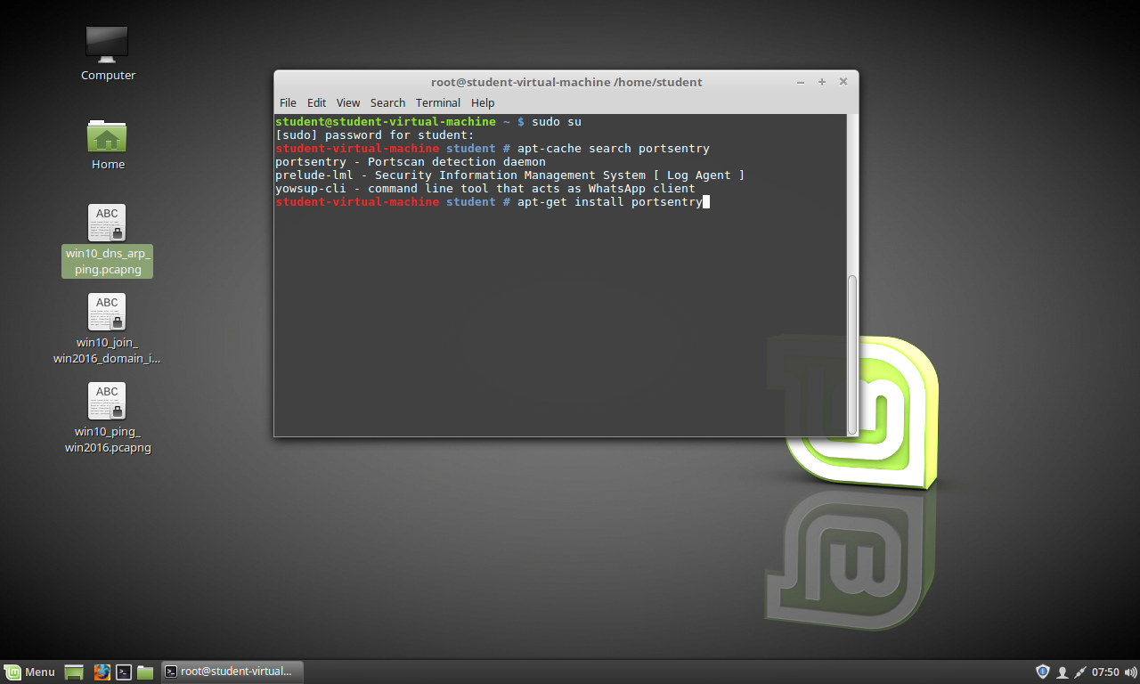
Port Sentry

Slide 8
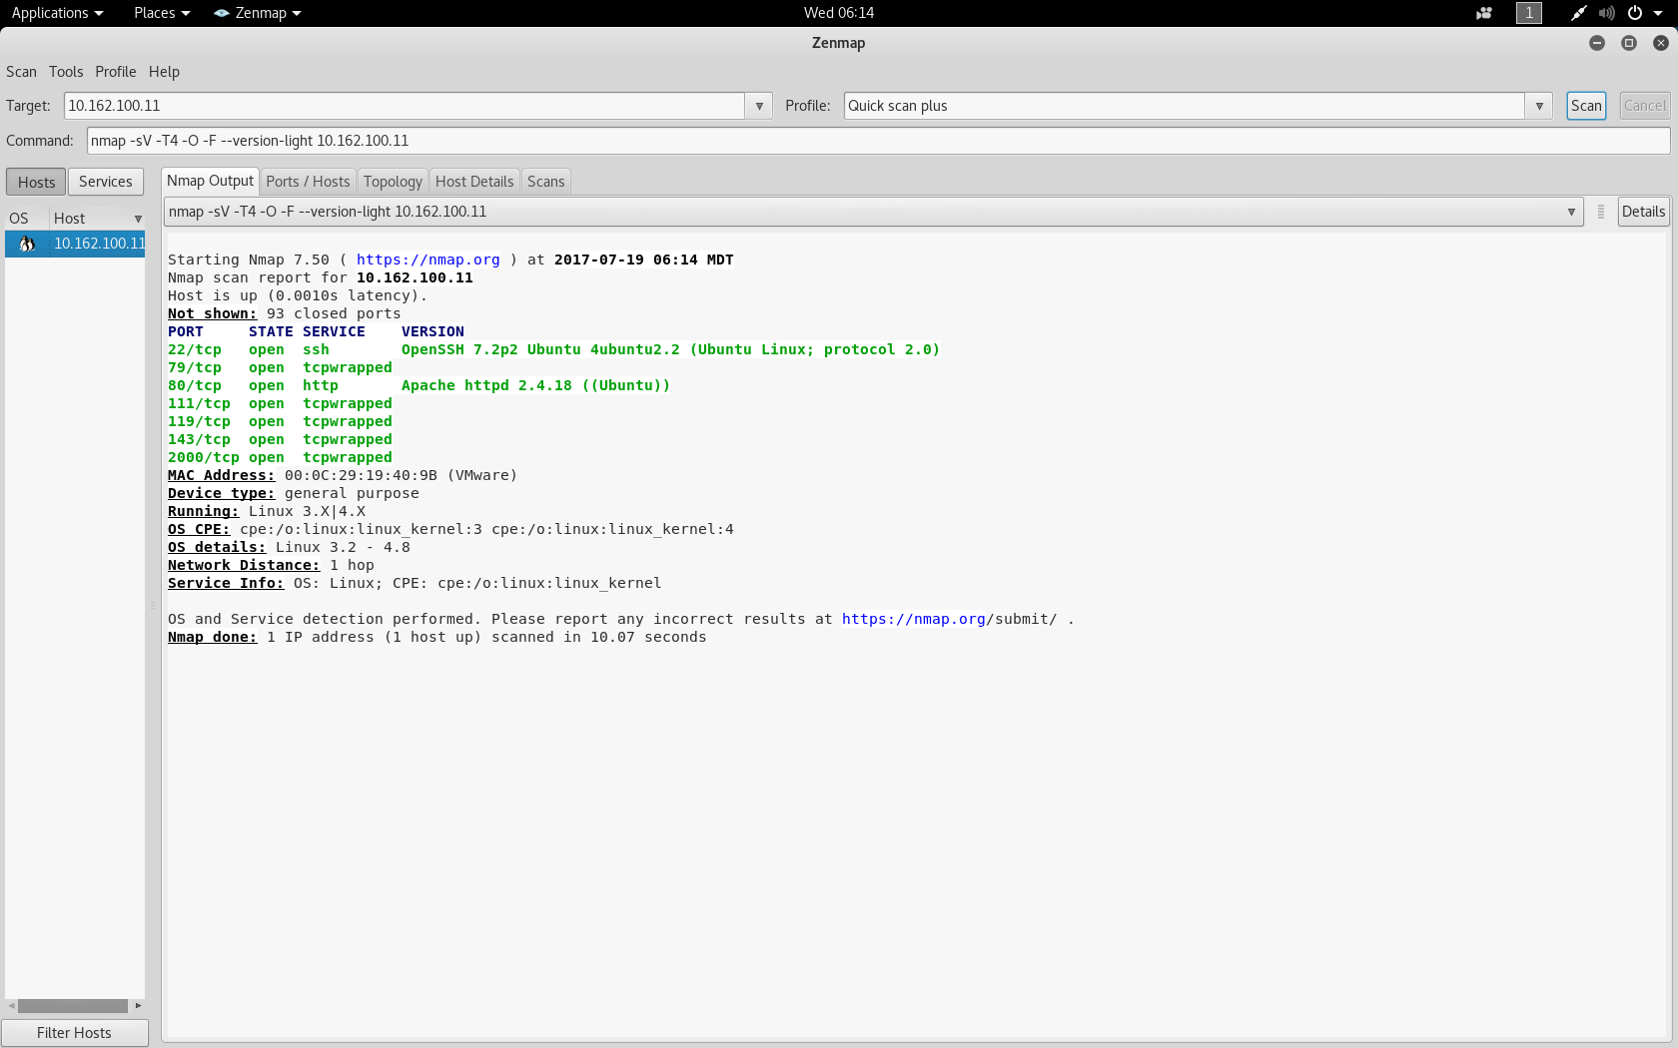
Port Sentry

Slide 9
Port Sentry

Slide 10
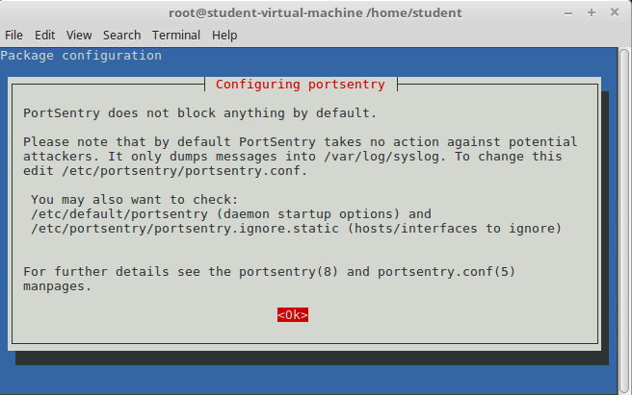
Port Sentry

Slide 11
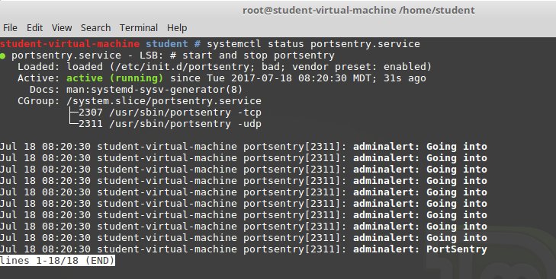
Port Sentry

Slide 12
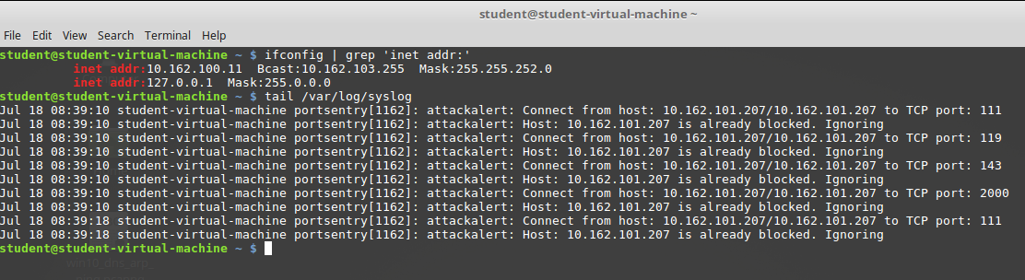
Port Sentry

Slide 13
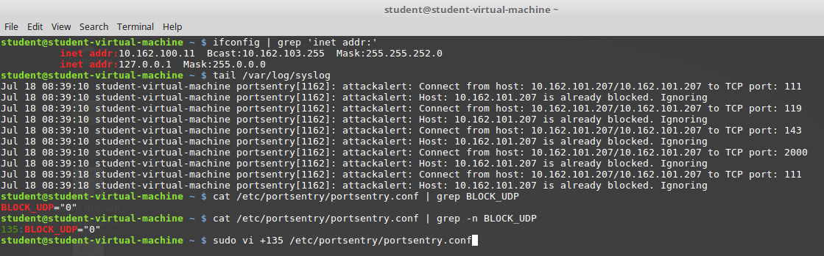
Port Sentry

Slide 14
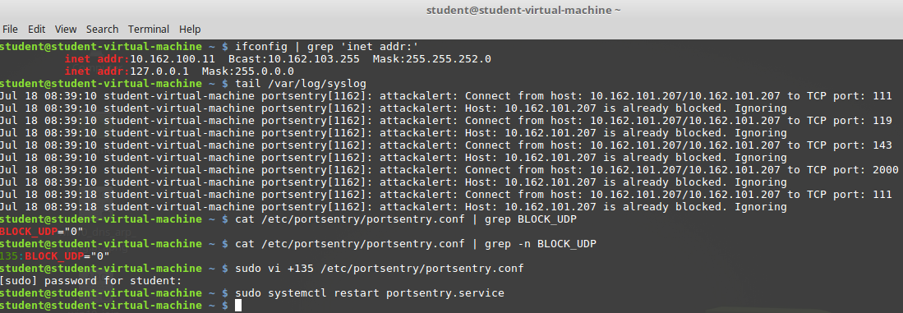
Port Sentry

Slide 15
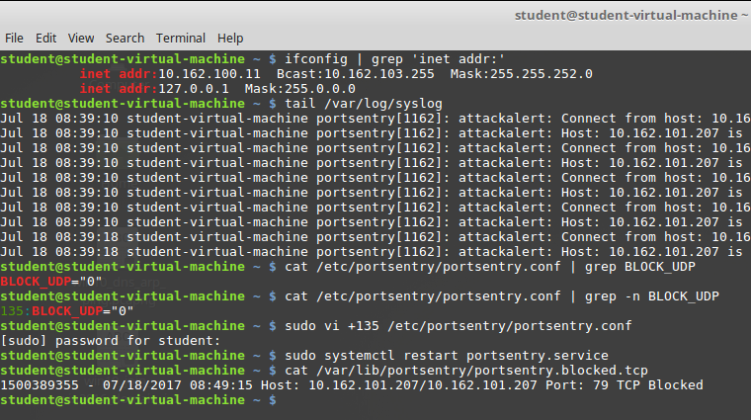
Port Sentry

Slide 16
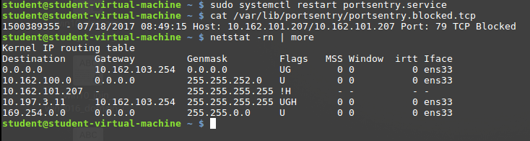
Port Sentry

Slide 17
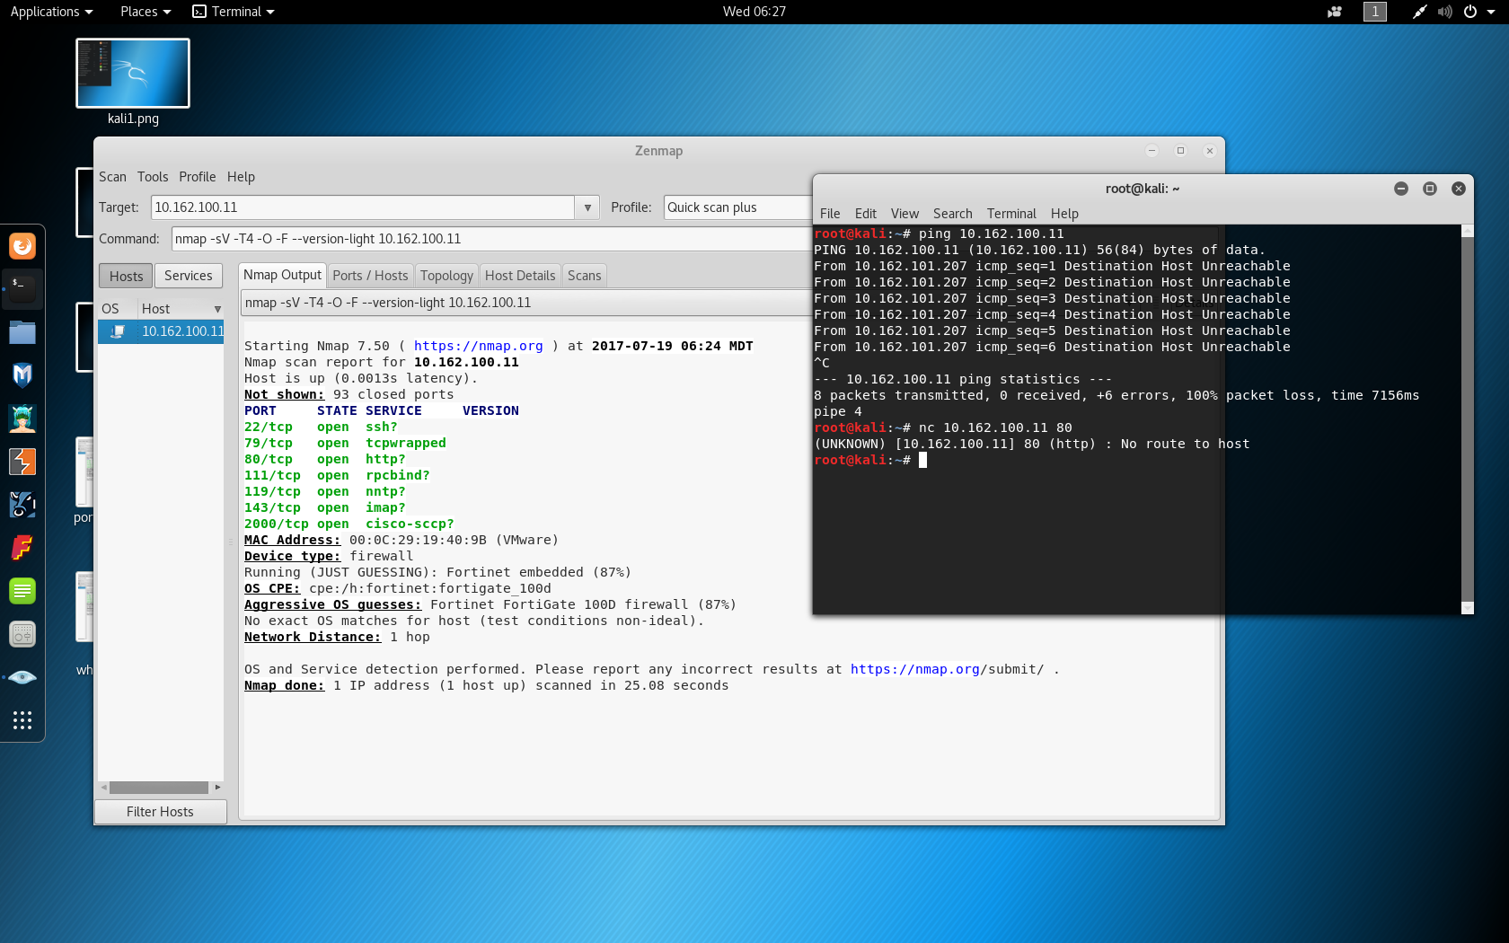
Port Sentry

Slide 18
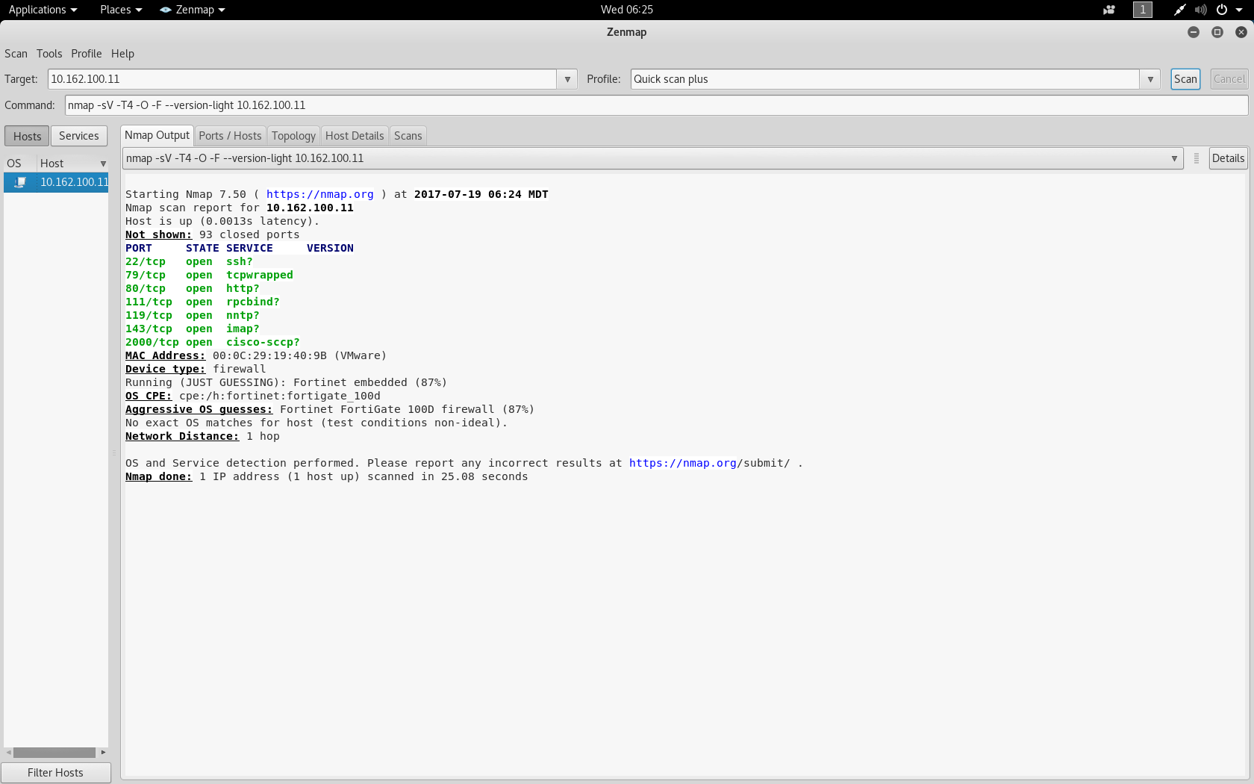
Port Sentry
Port Sentry not running
Port Sentry running

Slide 19
Controversy about Port Sentry
Some would think that this approach is an ideal way to be “invisible” on the Net. However, let’s look at it closely.
The normal response to a request for connection to a host that doesn’t exist or is shut down is an ICMP “host unreachable” message back to the requesting computer.
The lack of a response actually violates the normal rules of behavior on a TCP/IP network.
So the use of Port Sentry really only hides your computer from less experienced hackers. The good ones will know exactly what you are doing and change their source IP so they can continue to see you.

Slide 20

Coffee Break!

Slide 21
ARPWatch
ARPWatch is a relatively simple program that just watches for new MAC addresses on the local network and then notes them in syslog.
It should be noted that ARPWatch does nothing except email the network admin (if configured) when it logs a new MAC on the network.
For a more aggressive solution that will actually block new MAC addresses, look at ARPalert.

Slide 22
ARPWatch
Like Port Sentry, ARPWatch writes to the /var/log/syslog file by default.
Using the “tail” command, we can view that last 10 lines of any file … perfect for log files.
As soon as you start ARPWatch it starts listening for new MAC addresses it doesn’t know about and notes them in the syslog file.

Slide 23
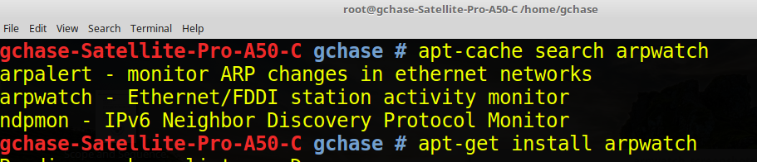
ARPWatch

Slide 24
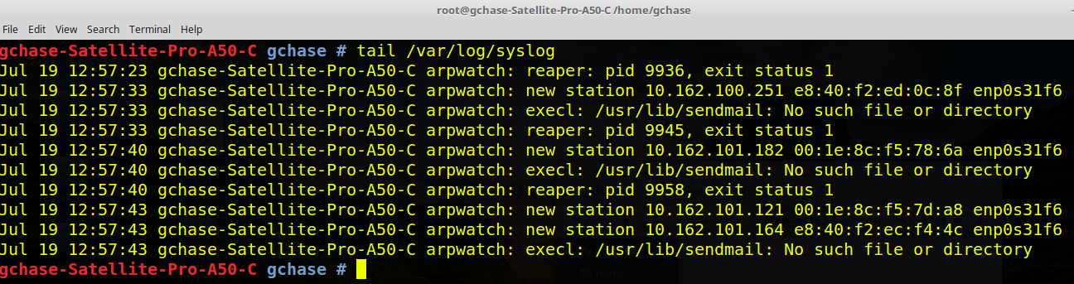
ARPWatch

Slide 25
Fail2ban
Fail2ban is a highly configurable utility that will dynamically add a firewall rule to Iptables to block source IP addresses that have a predefined number of failed logon attempts in a specified period of time.

Slide 26
Fail2ban
First install fail2ban
sudo apt-get install fail2ban
Create a /etc/fail2ban/jail.d/ssh.local file with this content :
[sshd]
enabled = true
port = ssh
logpath = %(sshd_log)s
maxretry = 3

Slide 27
Fail2ban
systemctl start fail2ban.service

Slide 28
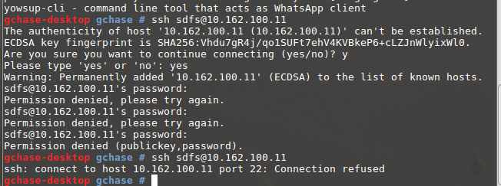
Fail2ban
After doing 4 failed logins from 10.162.101.197, I’m banned.

Slide 29
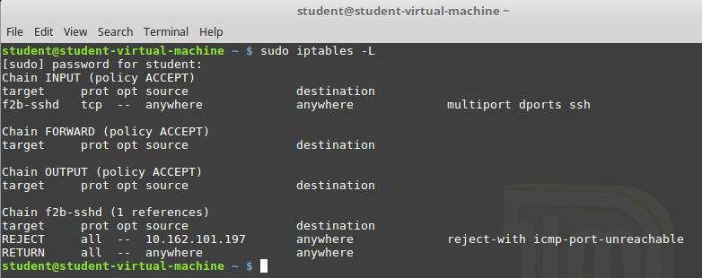
Fail2ban
Here is the firewall listing on the target computer. Notice the firewall rule listing a “reject all from 10.162.101.197”

Slide 30
Done

